Slide 1

Go, change the world
RV College of
Engineering
Internship Experiential Learning Phase 1
Gene Expression-Based Cancer Classification Using Machine Learning for Precision Oncology
Date: 19 - 12 - 2025

Slide 2

TEAM INTRODUCTION
RV College of
Engineering
Go, change the world
USN | Name | Email Id
1RV22CS187 | Shreejay Pandey | shreejaypandey.cs22@rvce.edu.in
RV COLLEGE OF ENGINEERING
2

Slide 3

Presentation Outline
RV College of
Engineering®
Go, change the world
Table of Contents
Introduction
Problem statement
Methodology
Literature review
Applications & Properties
Conclusion
References
Subject Coverage
Phase II plan

Slide 4
Introduction
Cancer classification at the molecular level is a critical requirement for precision oncology, as tumors that appear similar histologically may behave very differently at the genetic level. Gene expression profiling enables simultaneous measurement of thousands of genes, providing rich molecular signatures that can distinguish cancer subtypes. However, the extreme dimensionality of transcriptomic data, combined with limited patient samples, makes direct analysis challenging and computationally expensive.
RV COLLEGE OF ENGINEERING
4

Slide 5
Problem Statement
Despite the availability of large-scale gene expression datasets, traditional diagnostic and statistical methods struggle to extract clinically meaningful patterns due to noise, redundancy, and high feature dimensionality. Without appropriate feature reduction and model selection, classification performance degrades and interpretability becomes limited. Hence, there is a need for a structured framework that reduces dimensionality while preserving biologically relevant information.
RV COLLEGE OF ENGINEERING
5

Slide 6
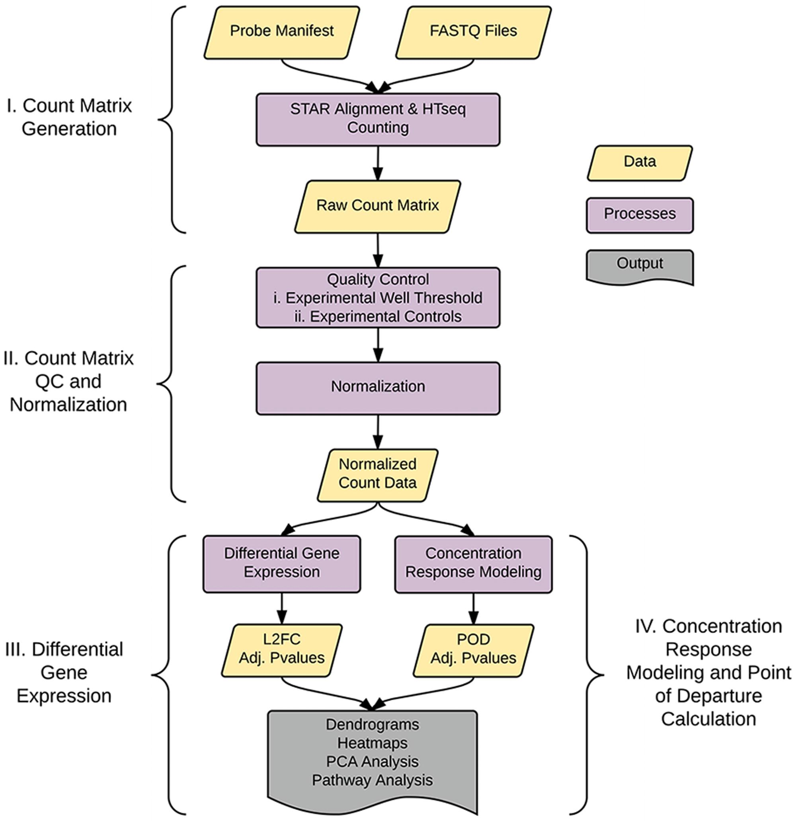
Go, change the world
RV College of
Engineering
Methodology
Flowchart of the experiment

Slide 7
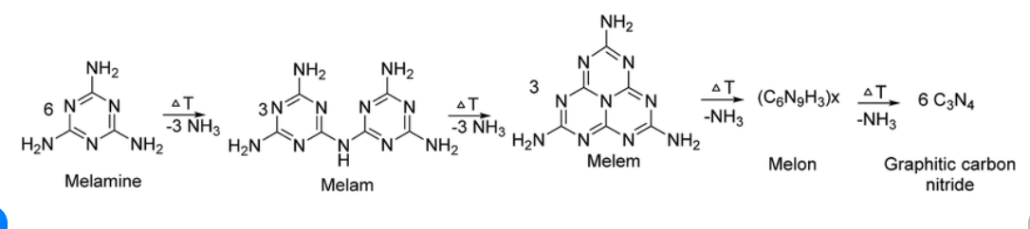
Go, change the world
Methodology
RV College of
Engineering
The proposed methodology follows a structured machine learning pipeline designed specifically for high-dimensional biological data. The workflow begins with preprocessing of raw gene expression values to ensure data consistency and comparability across samples. Dimensionality reduction techniques are then applied to compress the feature space while preserving biologically relevant information. The reduced feature representations are used to train multiple supervised classification models, allowing a comparative evaluation of their performance. Finally, statistical metrics are employed to validate model effectiveness and robustness.
These Include:
Data preprocessing and normalization
Dimensionality reduction using PCA and autoencoders
Classification using multiple machine learning models
Performance evaluation using standard metrics
7

Slide 8
DIMENSIONALITY REDUCTION
Dimensionality reduction plays a crucial role in handling RNA-seq data by transforming thousands of correlated gene features into a smaller, more informative feature space. Principal Component Analysis (PCA) captures dominant linear variance patterns, enabling visualization and initial separability assessment. Autoencoders, on the other hand, learn non-linear compressed representations through neural networks, allowing more complex biological relationships to be preserved. Together, these techniques significantly reduce computational complexity while improving downstream classification performance.
PCA captures maximum variance through orthogonal components
Autoencoders model non-linear gene interactions
Reduced features improve learning efficiency and stability

Slide 9
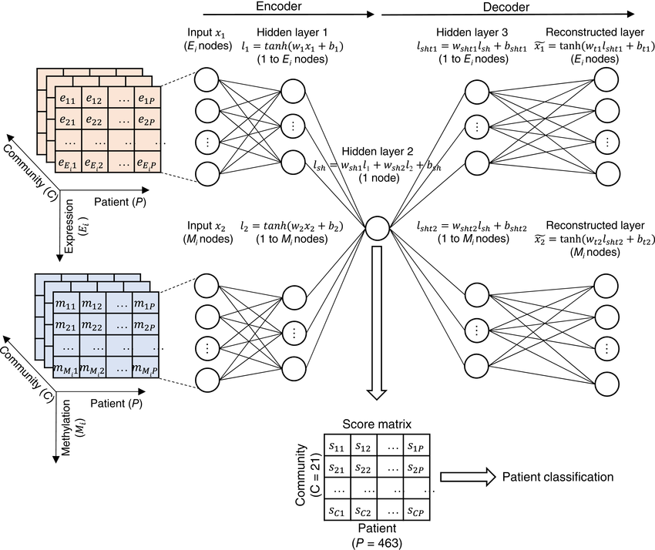
DIMENSIONALITY REDUCTION

Slide 10
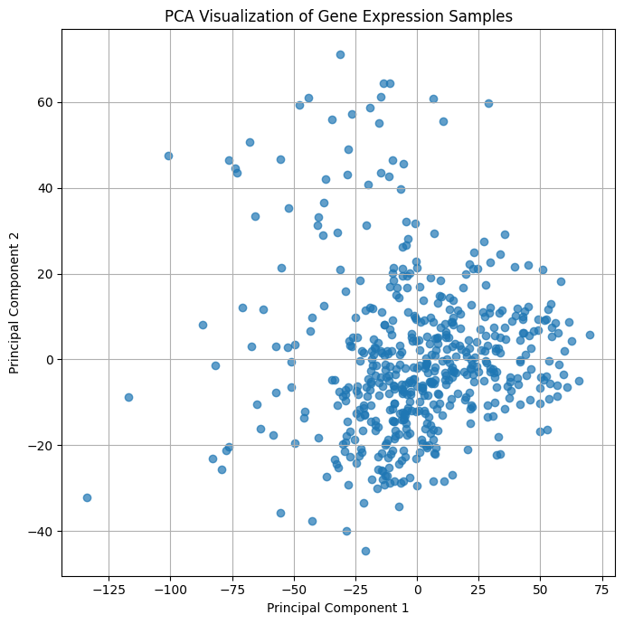
PCA VISUALIZATION
PCA visualization provides an intuitive understanding of the structure of gene expression data after dimensionality reduction. By projecting samples onto the first two principal components, it becomes possible to observe clustering patterns and overlap between cancer subtypes. Clear separation indicates strong discriminative potential, while partial overlap reflects biological similarity between certain tumor classes. This step validates whether reduced features retain meaningful biological information.
Two principal components summarize dominant gene variance
Clustering trends indicate subtype separability
Overlap reflects shared molecular characteristics

Slide 11
CLASSIFICATION MODELS
Multiple supervised learning algorithms were employed to evaluate classification performance under different modeling assumptions. Support Vector Machines are effective for high-dimensional spaces due to margin maximization, while Random Forests leverage ensemble learning to improve robustness. Logistic Regression provides insight into linear separability, and K-Nearest Neighbors serves as a distance-based baseline. Using multiple models ensures a comprehensive and unbiased comparison.
These are:
SVM:Margin-based classifier designed for high-dimensional spaces; constructs an optimal separating hyperplane using support vectors and kernel functions, making it highly effective for complex gene expression patterns.
Random Forest: Ensemble-based learning model that aggregates multiple decision trees; reduces variance and overfitting while capturing non-linear gene interactions through random feature and sample selection.
Logistic Regression: Probabilistic linear classifier that models class membership likelihood; provides stable baseline performance and interpretability for evaluating separability of reduced gene expression features.
KNN:Instance-based, distance-driven classifier that assigns labels based on nearest neighbors; serves as a simple baseline to analyze local similarity and clustering in gene expression data.

Slide 12
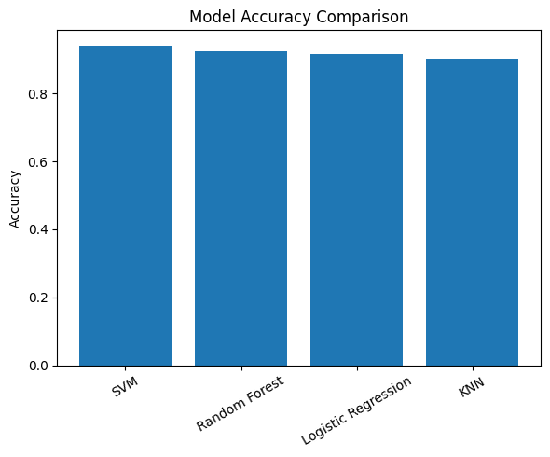
RESULTS: MODEL PERFORMANCE
The experimental results demonstrate that dimensionality reduction combined with supervised learning significantly enhances classification accuracy. Among all evaluated models, Support Vector Machine achieved the highest performance, indicating strong class separability in the reduced feature space. Random Forest closely followed, reflecting its ability to handle complex decision boundaries. The results confirm that feature compression plays a critical role in improving predictive reliability.
These Include:
SVM achieved highest accuracy and ROC-AUC
Random Forest showed stable performance
KNN performed comparatively lower due to density sensitivity

Slide 13
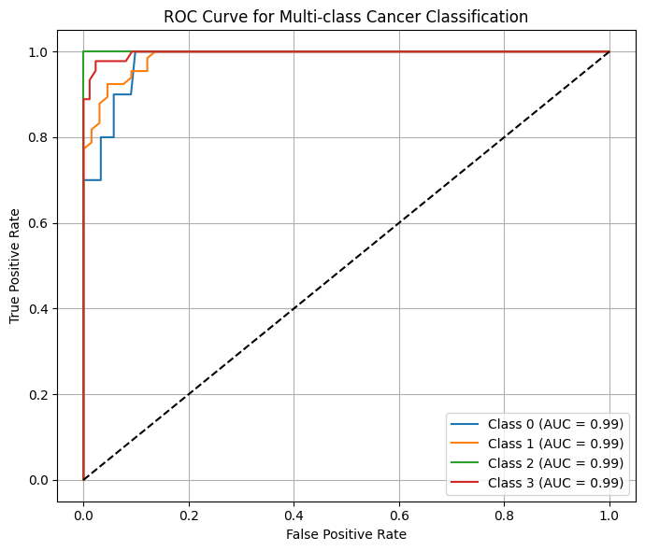
ROC CURVE ANALYSIS
Receiver Operating Characteristic (ROC) curves were used to evaluate classifier performance across different decision thresholds. High knowing the true positive rate against false positive rate allows assessment of model discriminative ability independent of class imbalance. The near-unity AUC values across classes indicate excellent separability, especially for SVM and Random Forest models.
ROC-AUC close to 1.0 indicates strong discrimination
Consistent performance across all classes
Threshold-independent evaluation

Slide 14
Literature Review
Title | Authors | Year of Publication
Reducing the Dimensionality of Data with Neural Networks Applications and Techniques of Machine Learning in Cancer Classification: A Systematic Review | G. E. Hinton, R. R. Salakhutdinov Abrar Yaqoob · Rabia Musheer Aziz · Navneet Kumar verma | 2006 2023
RV COLLEGE OF ENGINEERING
14

Slide 15
Literature Review
INFERENCE
Previous studies have demonstrated the effectiveness of machine learning techniques for cancer classification using gene expression data. Classical models such as SVM and Random Forest have consistently shown strong performance on high-dimensional biological datasets. Recent approaches incorporate deep learning for feature representation; however, these often suffer from limited interpretability and increased computational cost. This work builds upon existing literature by integrating dimensionality reduction with classical machine learning models to achieve balanced performance and interpretability.
Machine learning widely applied in transcriptomics
Deep learning improves representation but reduces interpretability
Hybrid approaches offer balanced performance

Slide 16
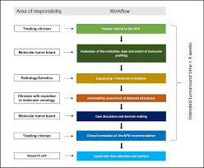
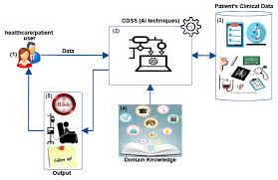
APPLICATIONS & PROPERTIES
The proposed framework has significant practical applications in precision oncology and biomedical research. Accurate cancer subtype classification can support early diagnosis, personalized treatment planning, and prognosis estimation. Additionally, the model’s modular design allows easy extension to other omics datasets, making it suitable for integrative multi-omics studies.
Some of the other uses are:
Precision oncology decision support
Biomarker discovery
Extension to proteomics and metabolomics

Slide 17
SUBJECT COVERAGE
This work lies at the intersection of computer science, biotechnology, and data science, combining computational modeling with biological interpretation to address cancer classification using gene expression data. The study demonstrates how machine learning and statistical techniques can be effectively applied to high-dimensional RNA-sequencing datasets to uncover meaningful molecular patterns. By integrating principles from bioinformatics, molecular biology, and data analytics, the work reflects a modern interdisciplinary approach that aligns with current computational biology curricula and industry-driven biomedical research practices.
Key Subject Areas Covered:
Machine Learning: Supervised classification models, performance evaluation, and model comparison.
Bioinformatics: RNA-sequencing data analysis and gene expression profiling.
Data Science: Preprocessing, normalization, dimensionality reduction, and statistical validation.
Molecular Biology: Understanding cancer heterogeneity at the gene expression level.
Computational Biology: Integration of biological data with computational frameworks for clinical insight.
Notes:
This slide highlights how the project does not belong to a single discipline but instead connects multiple fields that are essential for modern cancer research. Machine learning provides the predictive framework, bioinformatics handles biological data processing, and molecular biology gives biological meaning to the results. Data science ensures robustness and scalability of the analysis. Such interdisciplinary integration is highly relevant for both academic research and real-world applications in precision oncology and healthcare analytics.

Slide 18

Go, change the world
RV College of
Engineering
Conclusion
This study demonstrated an effective and interpretable machine learning framework for cancer subtype classification using gene expression data. By combining dimensionality reduction techniques such as PCA and autoencoders with supervised learning models, the framework successfully addressed challenges associated with high-dimensional transcriptomic data. The results indicate that classical machine learning models, when supported by appropriate feature extraction, can achieve high accuracy and reliable performance in precision oncology applications.
Dimensionality reduction significantly improves model generalization.
Support Vector Machine achieved the highest classification accuracy.
Random Forest provided robust performance and feature interpretability.
Results validate the suitability of ML-based approaches for gene expression analysis
18

Slide 19
Go, change the world
RV College of
Engineering
References
  [1] The Cancer Genome Atlas Research Network, “Comprehensive molecular portraits of human breast tumors,” Nature, vol. 490, no. 7418, pp. 61–70, 2012.
  [2] I. T. Jolliffe and J. Cadima, “Principal component analysis: a review and recent developments,” Philosophical Transactions of the Royal Society A, vol. 374, no. 2065, 2016.
  [3] G. E. Hinton and R. R. Salakhutdinov, “Reducing the dimensionality of data with neural networks,” Science, vol. 313, no. 5786, pp. 504–507, 2006.
  [4] C. Cortes and V. Vapnik, “Support-vector networks,” Machine Learning, vol. 20, no. 3, pp. 273–297, 1995.
  [5] L. Breiman, “Random forests,” Machine Learning, vol. 45, no. 1, pp. 5–32, 2001.
  [6] D. W. Hosmer, S. Lemeshow, and R. Sturdivant, Applied Logistic Regression, Wiley Series in Probability and Statistics, 3rd ed., 2013.
  [7] T. Cover and P. Hart, “Nearest neighbor pattern classification,” IEEE Transactions on Information Theory, vol. 13, no. 1, pp. 21–27, 1967.
  [8] B. E. Ainsworth, J. R. Stillman, and J. M. Thompson, “Machine learning approaches in cancer research: a critical review,” Computational and Structural Biotechnology Journal, vol. 18, pp. 97–107, 2020.
19

Slide 20
Phase II Plan
In Phase II, the proposed framework will be extended to enhance biological relevance, scalability, and clinical applicability. The focus will be on incorporating additional data modalities, improving model interpretability, and validating the approach on larger and more diverse datasets to strengthen its translational potential in real-world biomedical research.
Integration of multi-omics data (proteomics, metabolomics).
Exploration of advanced deep learning and hybrid models.
Application of explainable AI (XAI) techniques for clinical trust.
Validation using larger, multi-center cancer datasets.
RV COLLEGE OF ENGINEERING
20

